Slide 2
“The kingdom of God is like this,” He said.
“A man scatters seed on the ground;

Slide 3
he sleeps and rises—night and day, and the seed
sprouts and grows—he doesn’t know how.

Slide 4
The soil produces a crop by itself—first the blade,
then the head, and then the ripe grain on the head.

Slide 5
But as soon as the crop is ready, he sends
for the sickle, because the harvest has come.”
Mark 4:26-29, HCSB

Slide 6
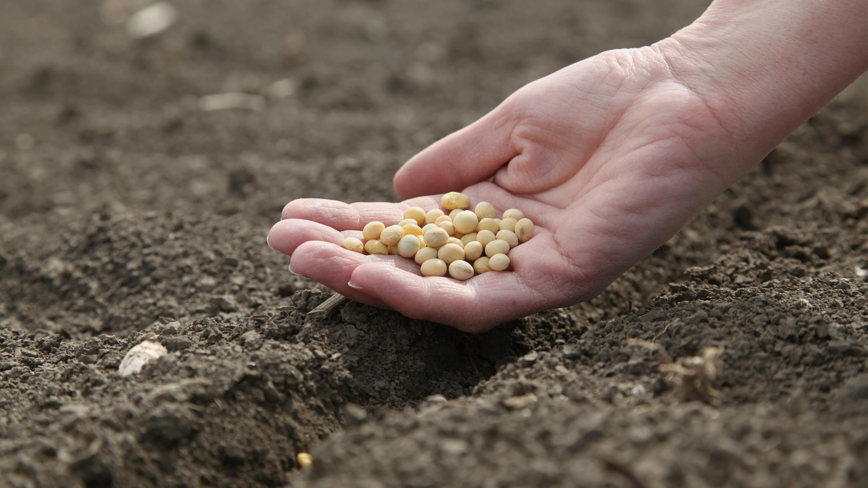
Nothing happens
until the seed is planted:
“A man scatters seed
on the ground”
(v. 26)

Slide 7
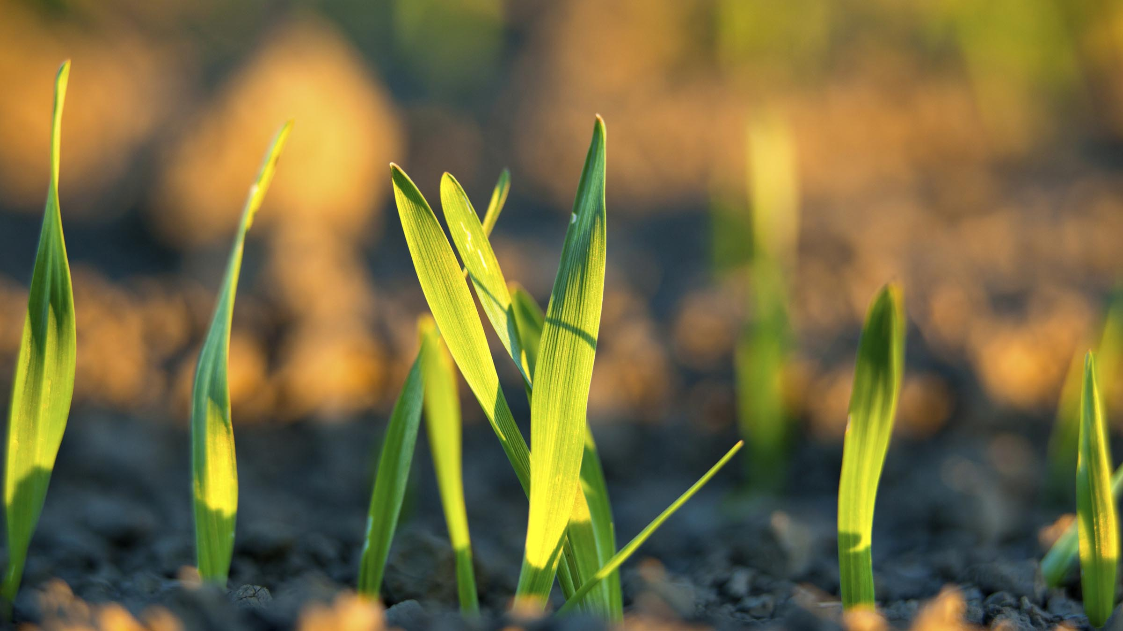
Visible results take time:
“he sleeps and rises -
night and day,”
(v. 27)

Slide 8
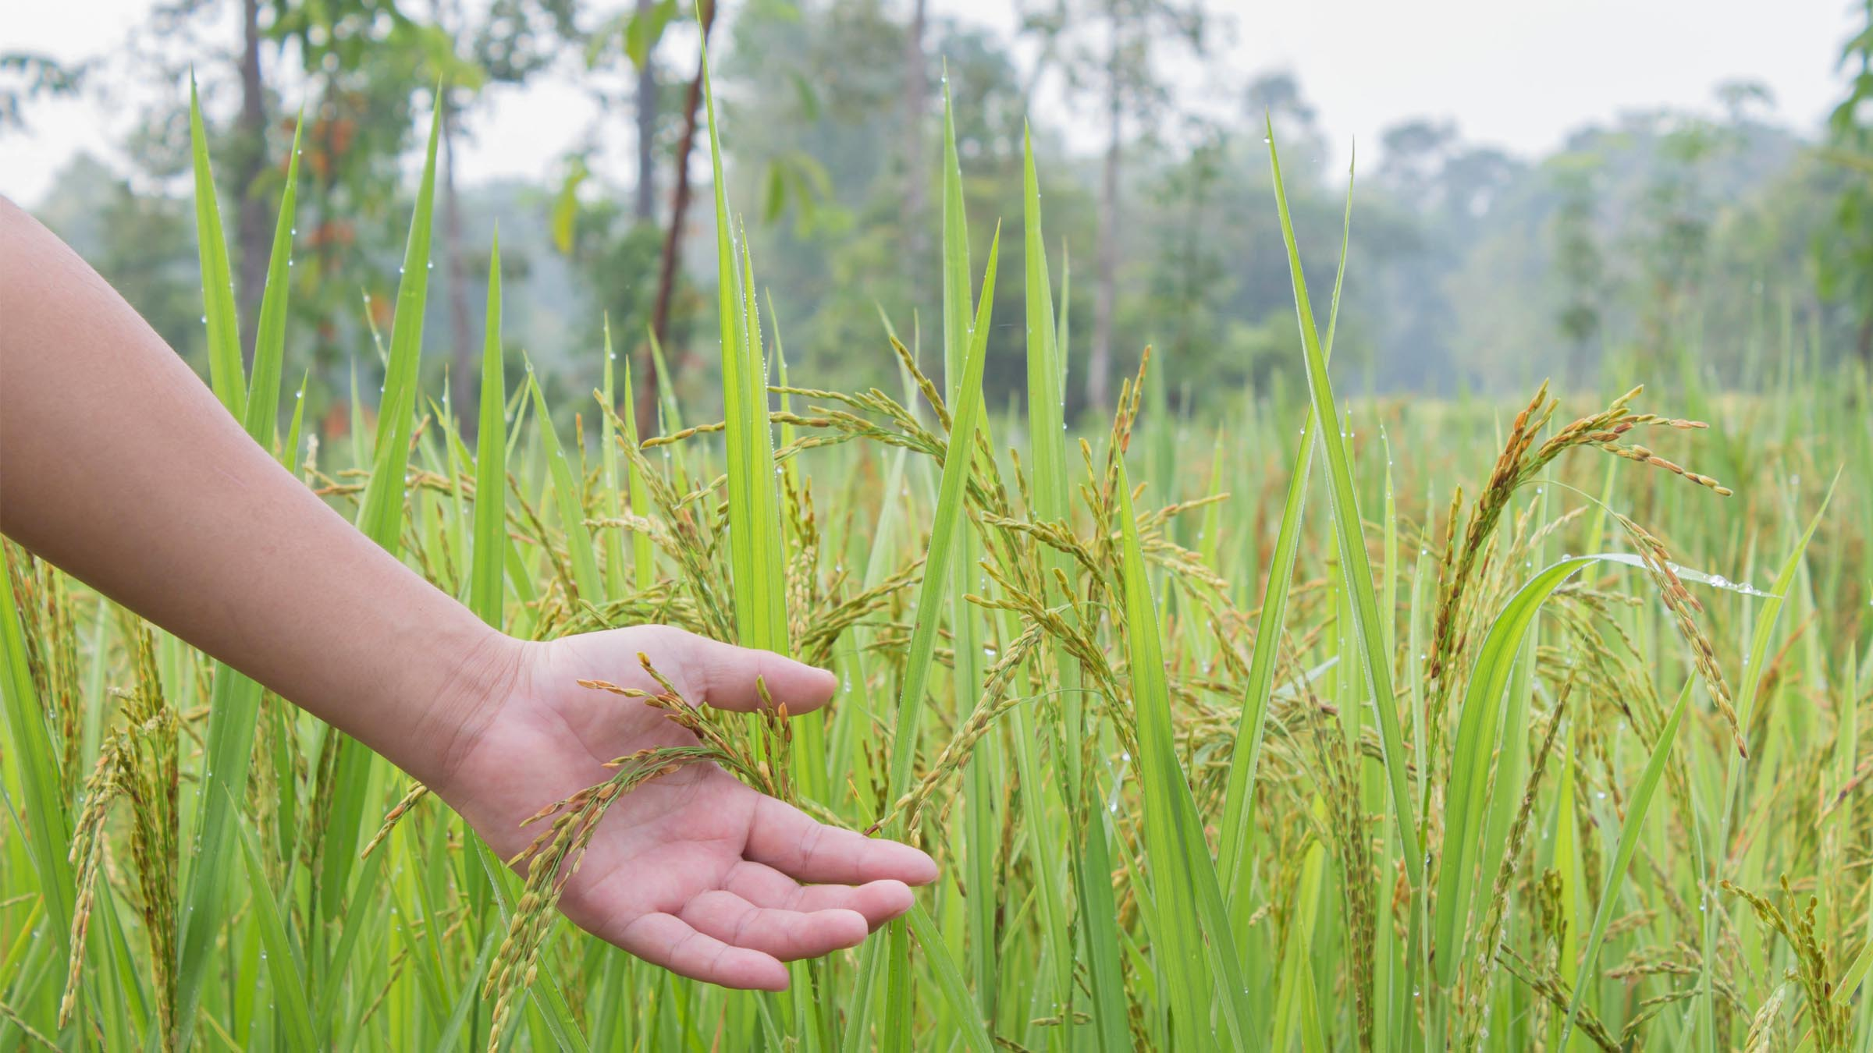
We don’t fully understand
what takes place:
“the seed sprouts and grows -
he doesn’t know how”
(v. 27)

Slide 9
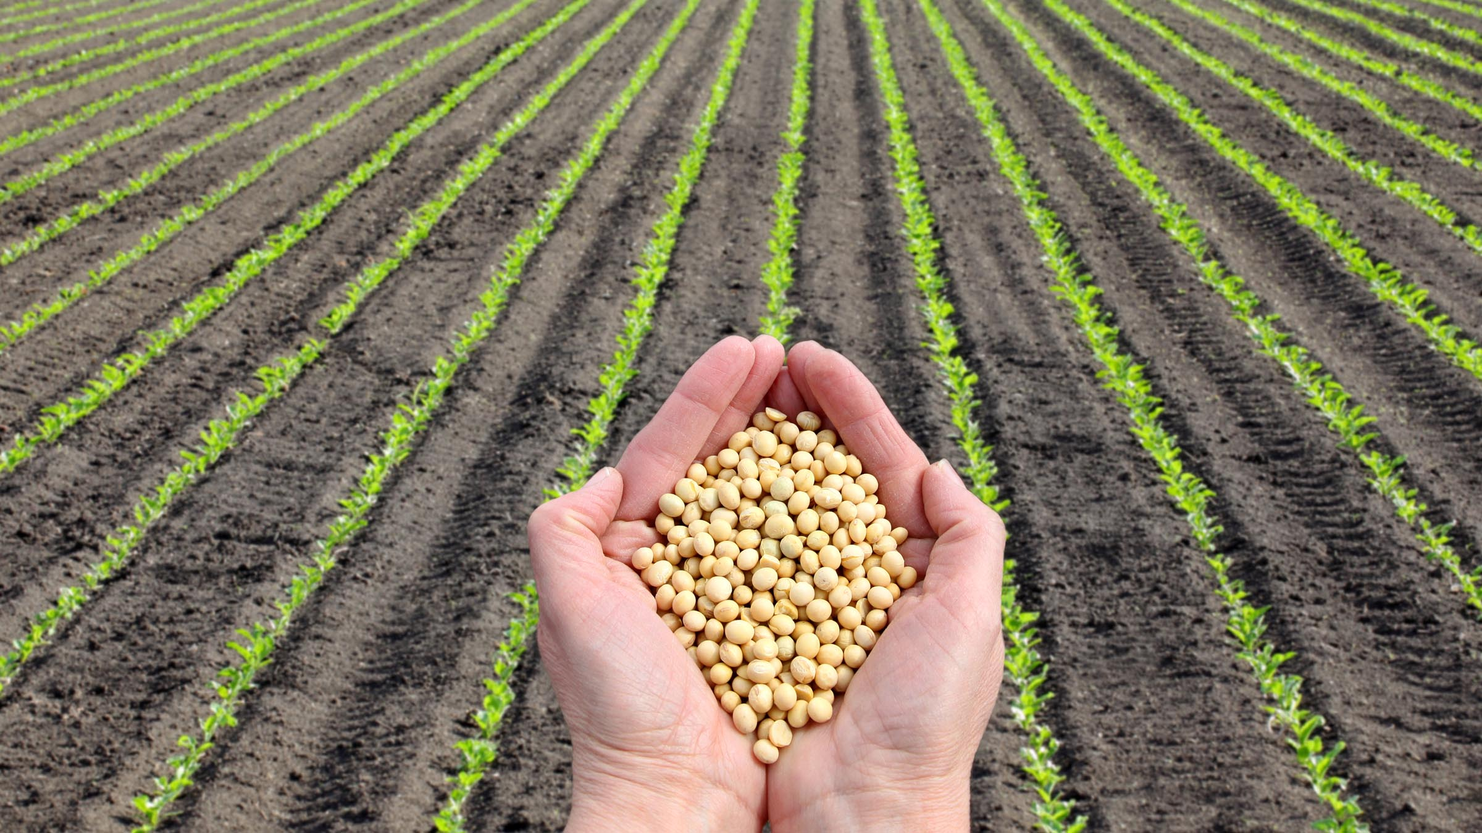
The fruit of our efforts are gradual:
“the soil produces a crop by itself - first the blade,
then the head, and then the ripe grain on the head”
(v. 28)

Slide 10
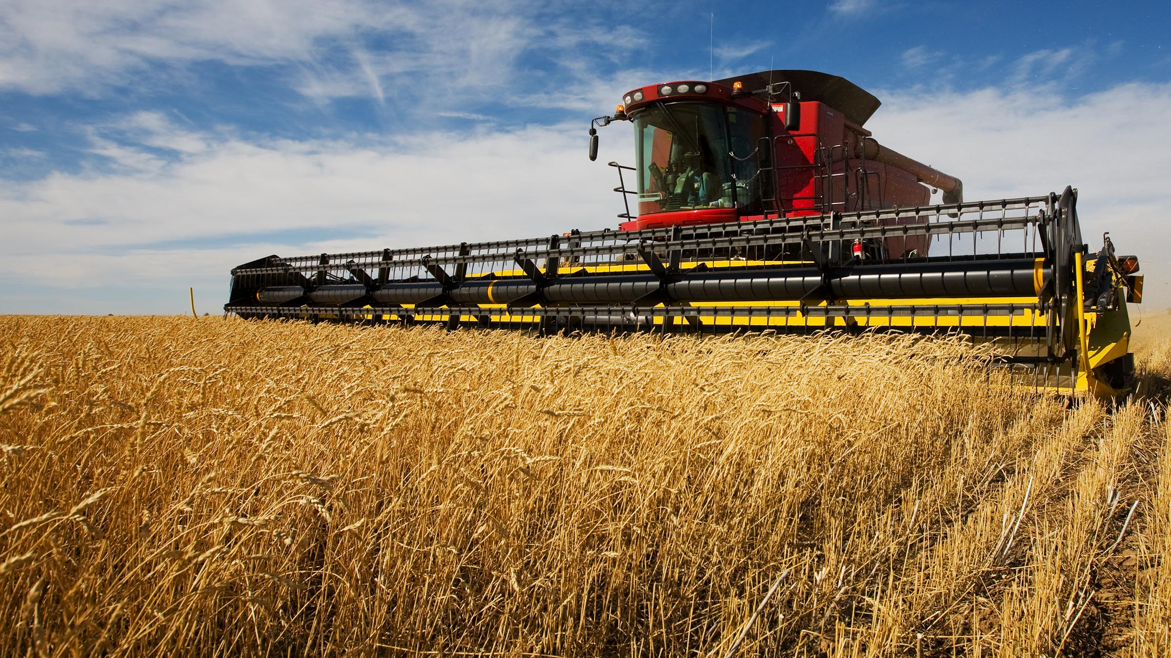
There is a harvest directly related to the scattered seed
“… he sends for the sickle because the harvest has come”
(v. 29)

Slide 11
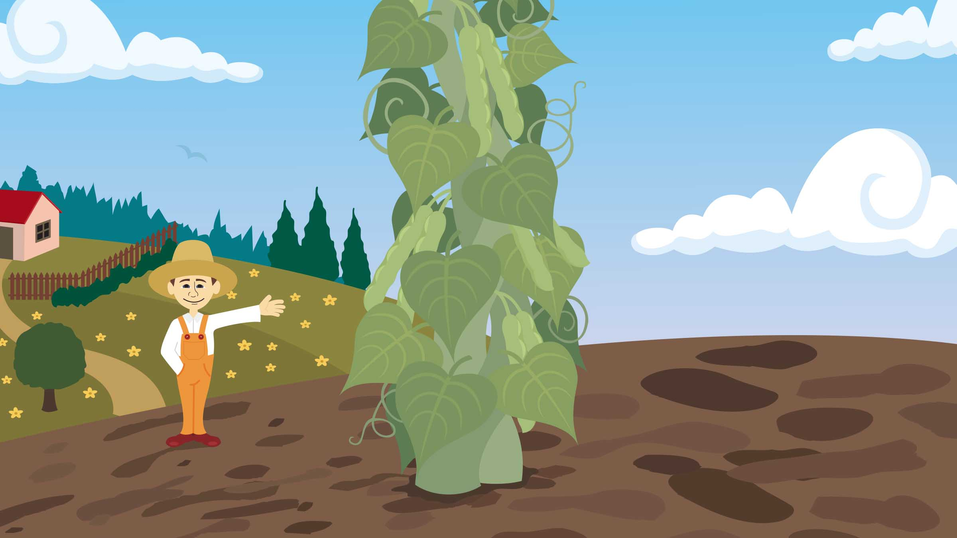
Jack and
the Beanstalk

Slide 12
"I revealed myself to those who did not ask for me; I was found by those
who did not seek me."
Is. 65:1

